Slide 1
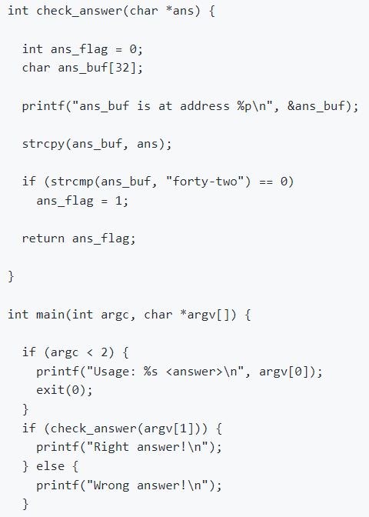
High address
Stack grows
argv
argc
arguments
Main’s
Stack frame
Return addr
Previous Frame Pointer
Local var
ans
arguments
Check_answer’s
Stack frame
Return addr
Previous Frame Pointer
ebp : current stack frame
Local var
esp : current stack pointer
Low address
[Stack and function invocation]

Slide 2
High address
Stack grows
argv
argc
arguments
Main’s
Stack frame
Return addr
Previous Frame Pointer
Local var
ans
arguments
Check_answer’s
Stack frame
Addr to injected code
padding
ebp : current stack frame
Injected code
esp : current stack pointer
Low address
[Lab3 - !ASRL && !NX]

Slide 3
High address
Stack grows
argv
/00
arguments
Main’s
Stack frame
Pop-ret
ret
ret
ret
arguments
Check_answer’s
Stack frame
ret
ret
ebp : current stack frame
Injected code
esp : current stack pointer
Low address
[Lab4 - ASRL && !NX]

Slide 4
High address
Stack grows
argv
argc
arguments
Main’s
Stack frame
Return addr
Previous Frame Pointer
&SHELL string
&exit()
arguments
Check_answer’s
Stack frame
&system()
padding
ebp : current stack frame
padding
esp : current stack pointer
Low address
[Lab5 - !ASRL && NX]

Slide 5
High address
Stack grows
argv
argc
arguments
Main’s
Stack frame
Return addr
Previous Frame Pointer
&to built string
&exit()
arguments
Check_answer’s
Stack frame
&system()
Build the string
ebp : current stack frame
padding
esp : current stack pointer
Low address
[Lab5_2 - ASRL && NX]

